Slide 1
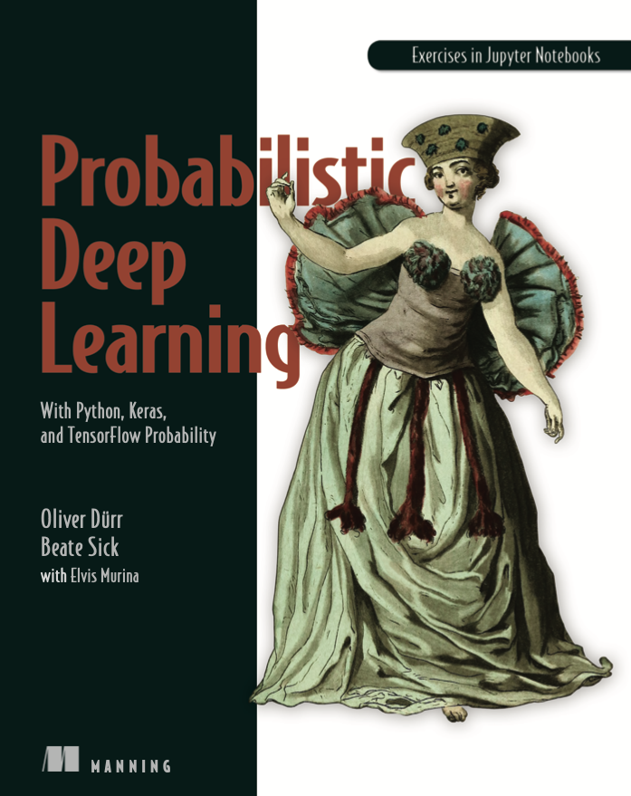
Intro to Normalizing Flow (For Modeling Complex Multi-dimensional Distributions)
Chapter 6.3 of Probabilistic Deep Learning
by Durr, Sick, and Murina (2020)

Slide 2
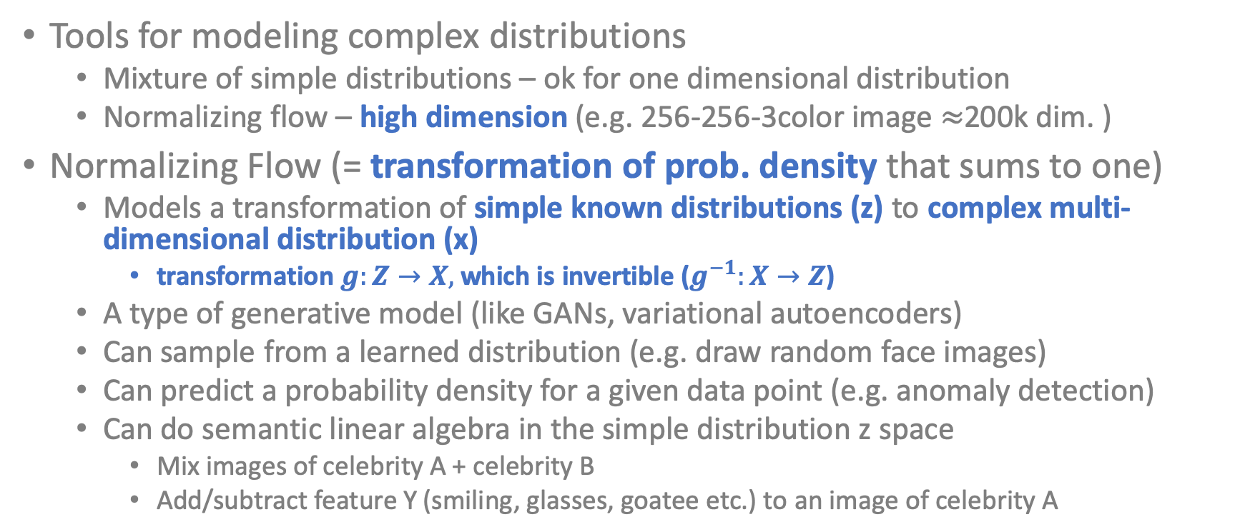
Model any complex distribution!
Tools for modeling complex distributions
Mixture of simple distributions – ok for one dimensional distribution
Normalizing flow – high dimension (e.g. 256-256-3color image $≈$200k dim. )
Normalizing Flow (= transformation of prob. density that sums to one)
Models a transformation of simple known distributions (z) to complex multi-dimensional distribution (x)
transformation $g:Z→X,$ which is invertible ($g^{−1}:X→Z$)
A type of generative model (like GANs, variational autoencoders)
Can sample from a learned distribution (e.g. draw random face images)
Can predict a probability density for a given data point (e.g. anomaly detection)
Can do semantic linear algebra in the simple distribution z space
Mix images of celebrity A + celebrity B
Add/subtract feature Y (smiling, glasses, goatee etc.) to an image of celebrity A

Slide 3
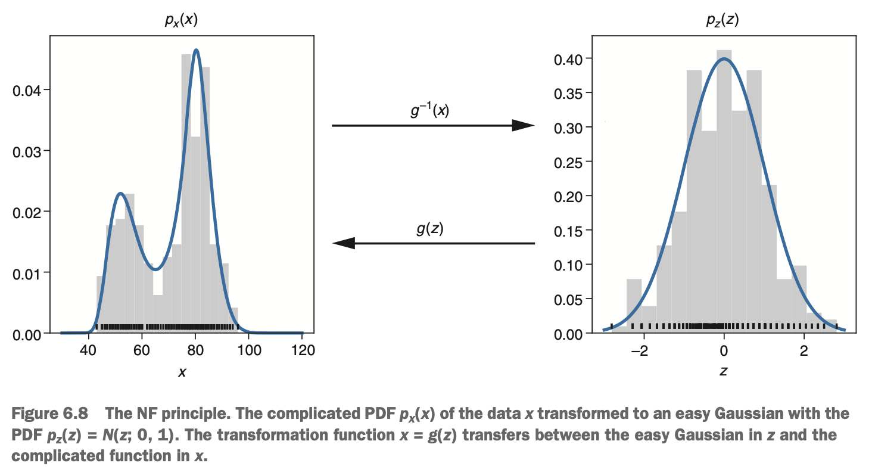
Example 1: one dimensional distribution

Slide 4
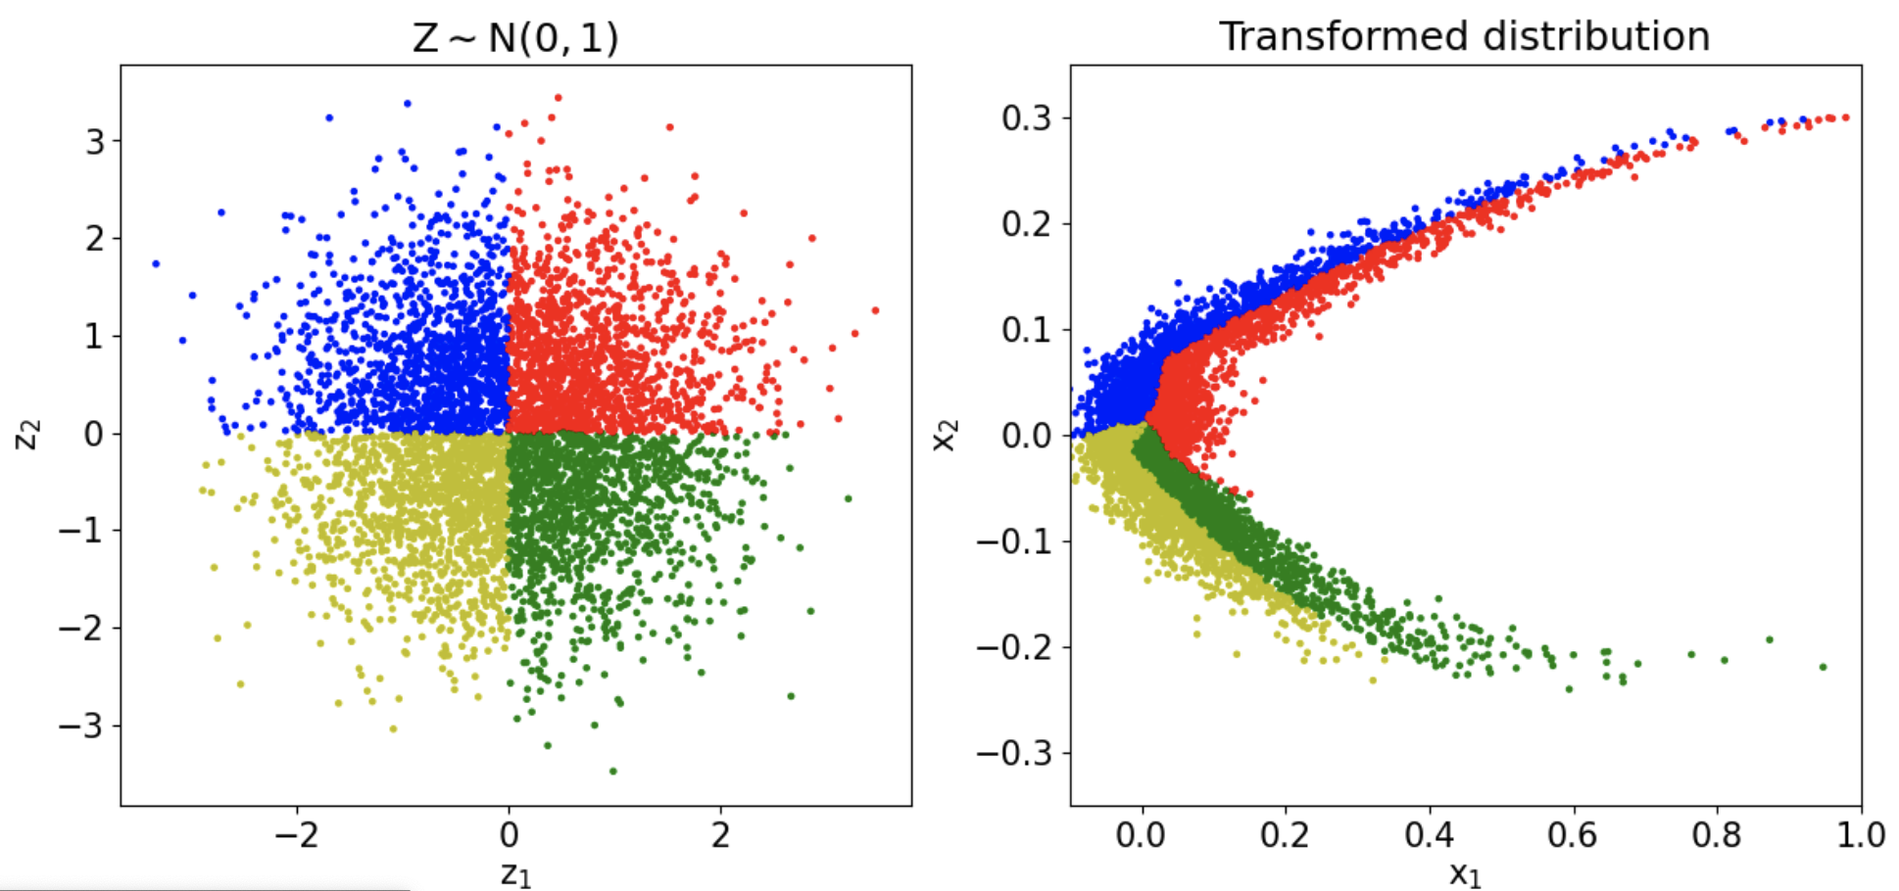
Example 2: two-dimensional distribution

Slide 5
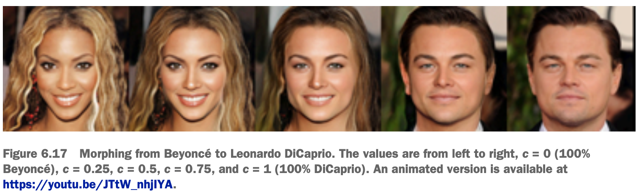
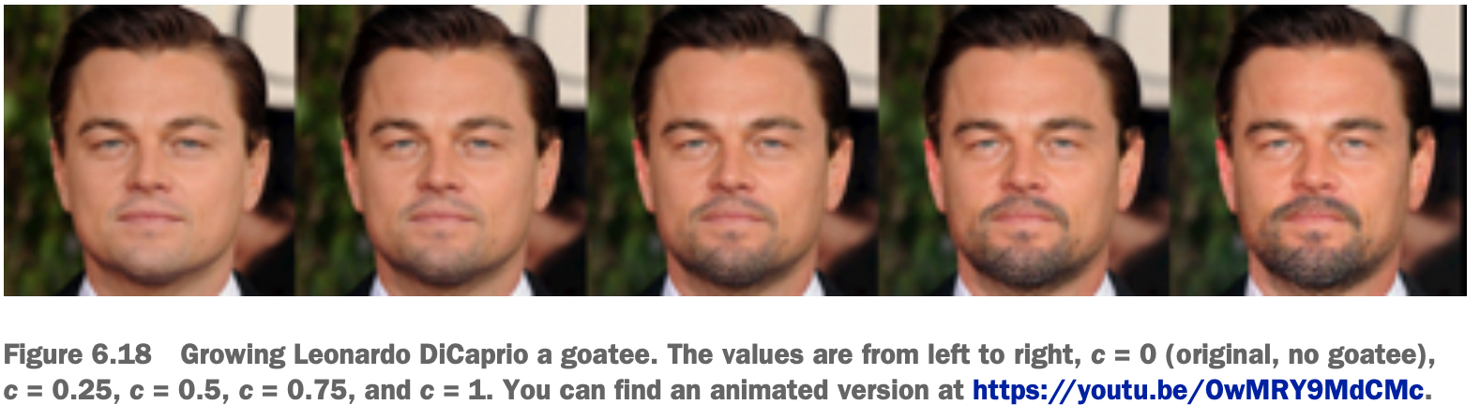
Example 3: high-dimensional distribution

Slide 6
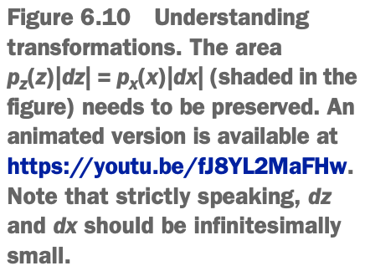
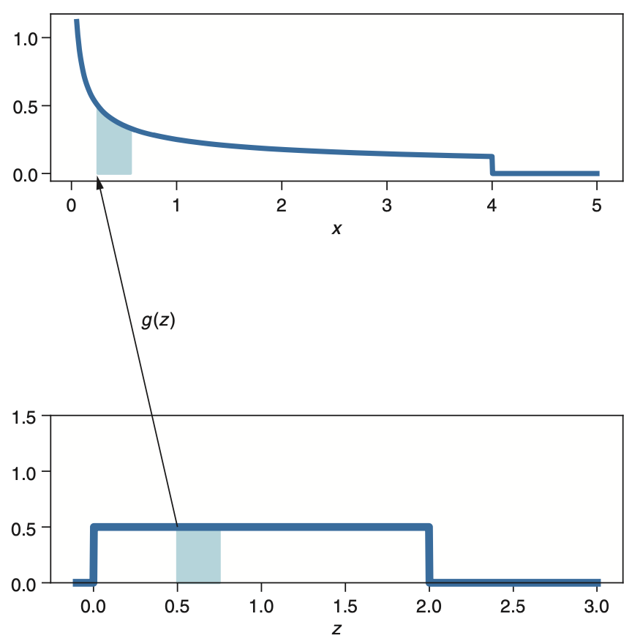
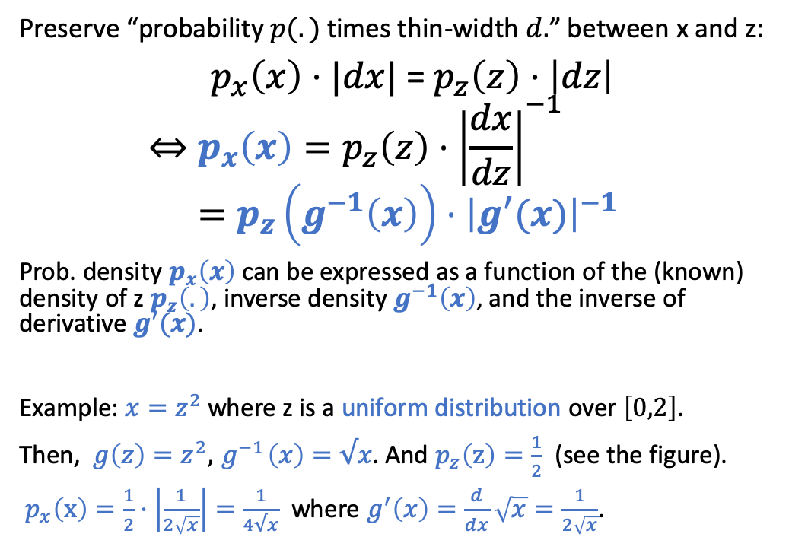
Change of Variable Formula
Preserve “probability $p(.)$ times thin-width $d.$” between x and z:
$p_{x}\left(x\right)⋅|dx|$ = $p_{z}\left(z\right)⋅\left|dz\right|$
$$⇔p_{x}\left(x\right)=p_{z}\left(z\right)⋅{\left|\frac{dx}{dz}\right|}^{−1} =p_{z}\left(g^{−1}\left(x\right)\right)⋅{\left|g^{′}(x)\right|}^{−1}$$
Prob. density $p_{x}\left(x\right)$ can be expressed as a function of the (known) density of z $p_{z}\left(.\right)$, inverse density $g^{−1}\left(x\right)$, and the inverse of derivative $g^{′}(x)$.
Example: $x=z^{2}$ where z is a uniform distribution over $\left[0,2\right]$.
Then, ${g\left(z\right)=z}^{2}, { g}^{−1}\left(x\right)=√x$. And $p_{z}\left(z\right)=\frac{1}{2}$ (see the figure).
$p_{x}\left(x\right)=\frac{1}{2}⋅\left|\frac{1}{2\sqrt{x}}\right|=\frac{1}{4√x}$ where $g^{′}\left(x\right)=\frac{d}{dx}\sqrt{x}=\frac{1}{2\sqrt{x}}$.

Slide 7
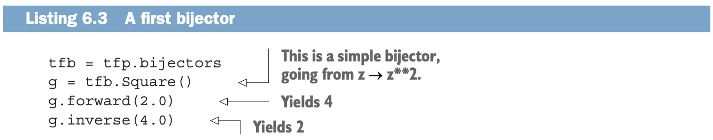
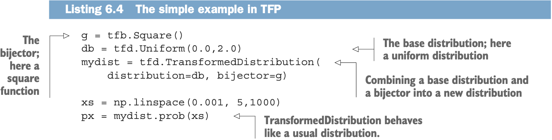
Bijector = invertible transformation
tfp = tensorflow_probability

Slide 8
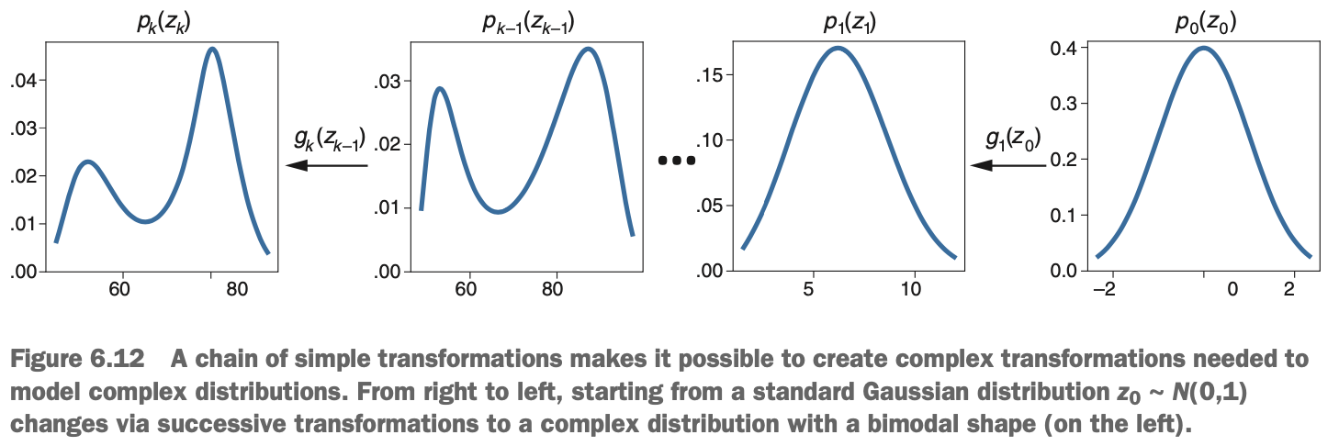


Stacked bijectors: $z_{0}→$ $z_{1}$ $→$ $z_{2}$ $→$... $→x$
Stacked bijectors are obtained by iterating change of variable formula:
$p_{z2}\left(z_{2}\right)=p_{z1}\left(z_{1}\right)⋅{\left|g_{2}^{′}\left(z_{1}\right)\right|}^{−1}=p_{z0}\left(z_{0}\right)⋅{\left|g_{1}^{′}\left(z_{0}\right)\right|}^{−1}⋅{\left|g_{2}^{′}\left(z_{1}\right)\right|}^{−1}$
Taking the log: $\ln{p_{z_{2}}\left(z_{2}\right)}=\ln{p_{z0}\left(z_{0}\right)}−ln{g_{1}^{′}\left(z_{0}\right)}−ln{g_{2}^{′}\left(z_{1}\right)}$
This generalizes to: $\ln{p_{x}\left(x\right)}= ln{p_{z0}\left(z_{0}\right)}−\sum_{k}{\frac{dg_{i}(z_{i−1})}{dz_{i−1}}}$

Slide 9
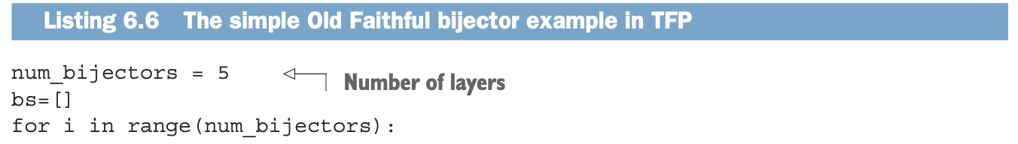
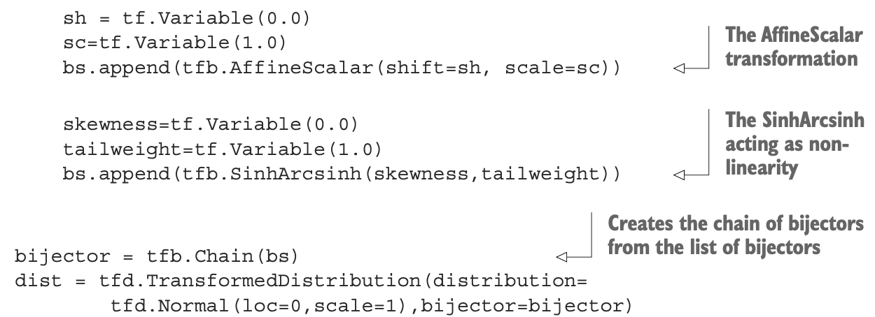
Modeling Old Faithful data with bijectors
Stack 5 layers of bijectors
tfb.SinhArchsinh is a type of flexible nonlinear transformation/bijector
dist.log_prob (=negative log likelihood) can be minimized via tf.GradientTape method.

Slide 10
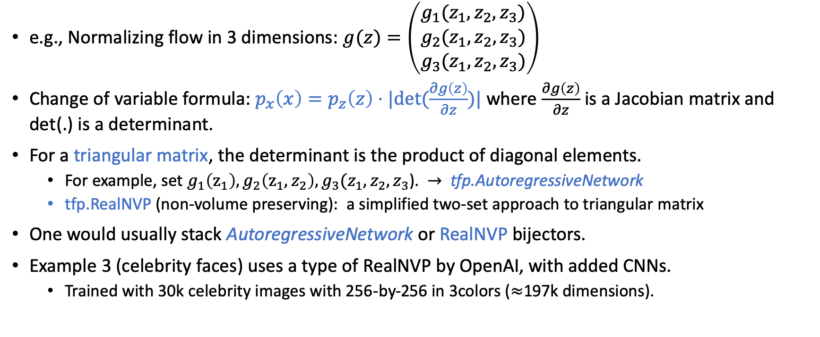
High-dimensional Distribution
e.g., Normalizing flow in 3 dimensions: $g(z)=\left(\begin{matrix}g_{1}(z_{1},z_{2},z_{3}) \\ g_{2}(z_{1},z_{2},z_{3}) \\ g_{3}(z_{1},z_{2},z_{3})\end{matrix}\right)$
Change of variable formula: $p_{x}\left(x\right)=p_{z}\left(z\right)⋅|det⁡(\frac{∂g\left(z\right)}{∂z})|$ where $\frac{∂g\left(z\right)}{∂z}$ is a Jacobian matrix and det(.) is a determinant.
For a triangular matrix, the determinant is the product of diagonal elements.
For example, set $g_{1}\left(z_{1}\right), g_{2}\left(z_{1},z_{2}\right),g_{3}(z_{1},z_{2},z_{3}$). $→$ tfp.AutoregressiveNetwork
tfp.RealNVP (non-volume preserving): a simplified two-set approach to triangular matrix
One would usually stack AutoregressiveNetwork or RealNVP bijectors.
Example 3 (celebrity faces) uses a type of RealNVP by OpenAI, with added CNNs.
Trained with 30k celebrity images with 256-by-256 in 3colors ($≈$197k dimensions).

Slide 11
Hands-on Demos
Run the Old Faithful example (from this textbook)
Run the Make Moons example (from Keras)
Run the Boomerang example (from this textbook)

